Slide 1

The 22 Immutable Laws Of Branding
Members
Ahmed Moeez 22l-7966
Abdul Ahad Tariq 22L-7866
Hammad Talat 22L-7858
Muhammad Hasnain 22L-7931

Slide 2
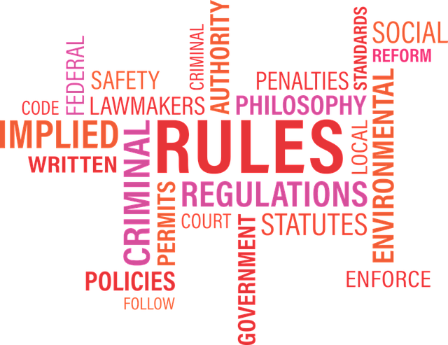
The Law
Of The Company

Slide 3
◤✧ 𝕭𝖗𝖆𝖓𝖉𝖘 𝖆𝖗𝖊 𝕭𝖗𝖆𝖓𝖉𝖘. 𝕮𝖔𝖒𝖕𝖆𝖓𝖎𝖊𝖘 𝖆𝖗𝖊 𝕮𝖔𝖒𝖕𝖆𝖓𝖎𝖊𝖘. 𝕿𝖍𝖊𝖗𝖊 𝖎𝖘 𝖆 𝕯𝖎𝖋𝖋𝖊𝖗𝖊𝖓𝖈𝖊 ✧◥

Slide 4

Company Name & Confusions
Biggest Confusion: Deciding an appropriate name for the company.
Company Name Domination ?

Slide 5
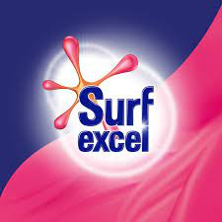
Company Name & Confusions
Biggest Confusion: Deciding an appropriate name for the company.
Company Name Domination ?
Brand Name Domination ?

Slide 6
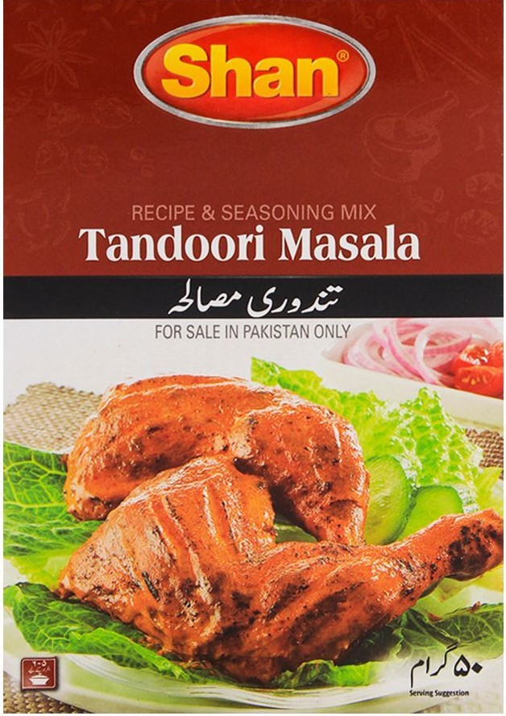
Company Name & Confusions
Biggest Confusion: Deciding an appropriate name for the company.
Company Name Domination ?
Brand Name Domination ?
Given Equal Weight ?

Slide 7
Company Name & Confusions
Biggest Confusion: Deciding an appropriate name for the company.
Company Name Domination ?
Brand Name Domination ?
Given Equal Weight ?

Slide 8
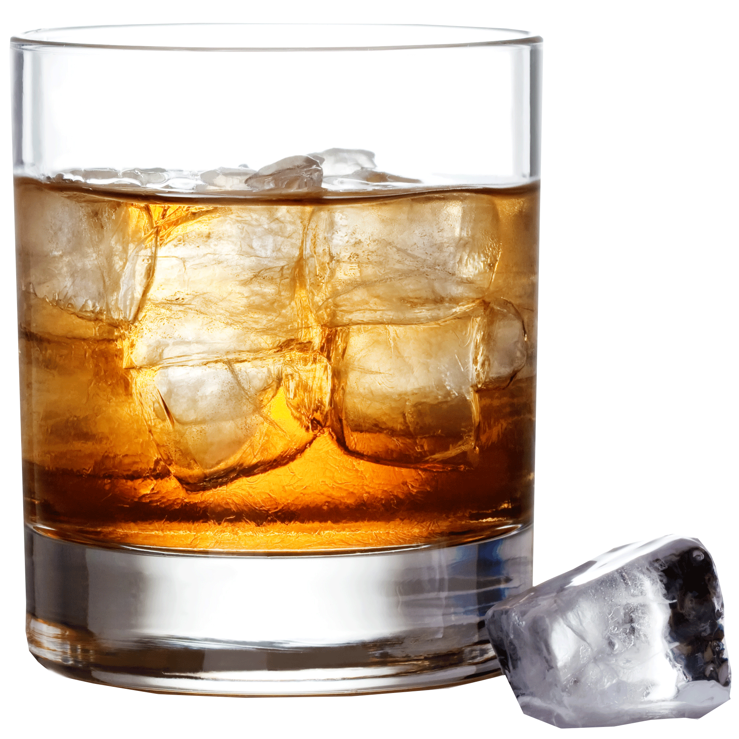
Brand Name Significance
Law 9: In the long run a brand is nothing more than a name.
SAQUIBOFF
BHATIWOSKI

Slide 9
Brand Name Significance
Law 9: In the long run a brand is nothing more than a name.
SAQUIBOFF
BHATIWOSKI

Slide 10
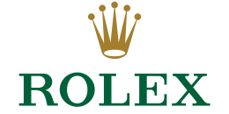
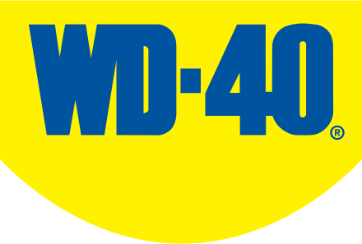
Suggested Convention
Brand names should almost always take precedence over company names.
Consumers buy brands not companies.
Using company names as brand names? Suggested

Slide 11
Suggested Convention
Brand names should almost always take precedence over company names.
Consumers buy brands not companies.
Using company names as brand names? Suggested

Slide 12
Two Perspectives
Management
Customer
Company
Oriented
Brand
Oriented

Slide 13
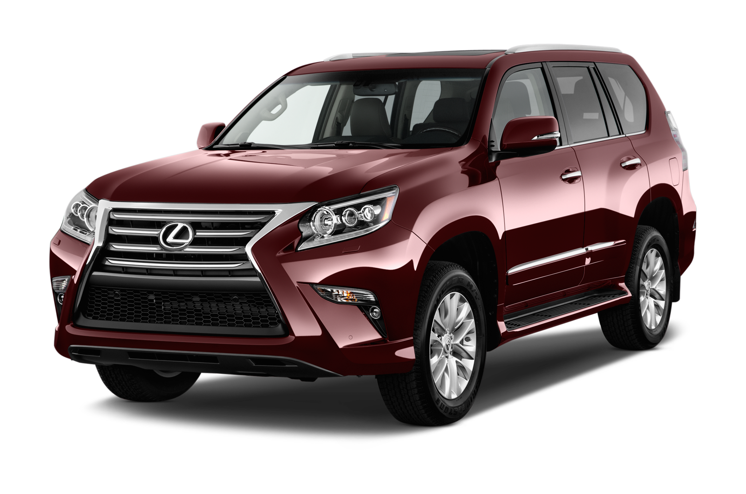
Two Perspectives
Management
Customer
Company
Oriented
Brand
Oriented

Slide 14
Two Perspectives
Management
Customer
Company
Oriented
Brand
Oriented

Slide 15
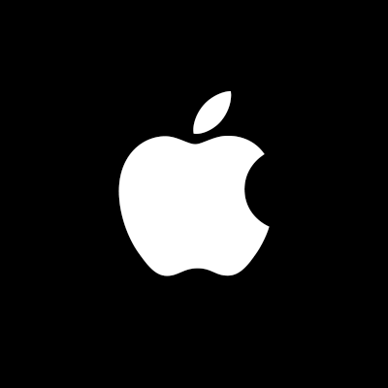
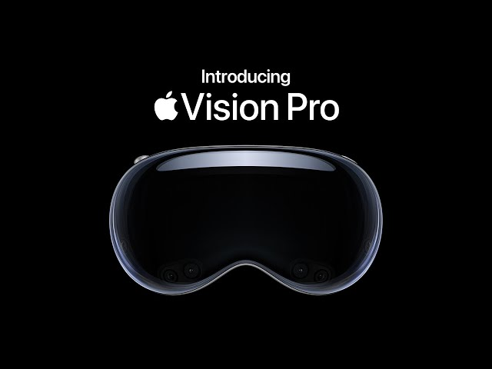
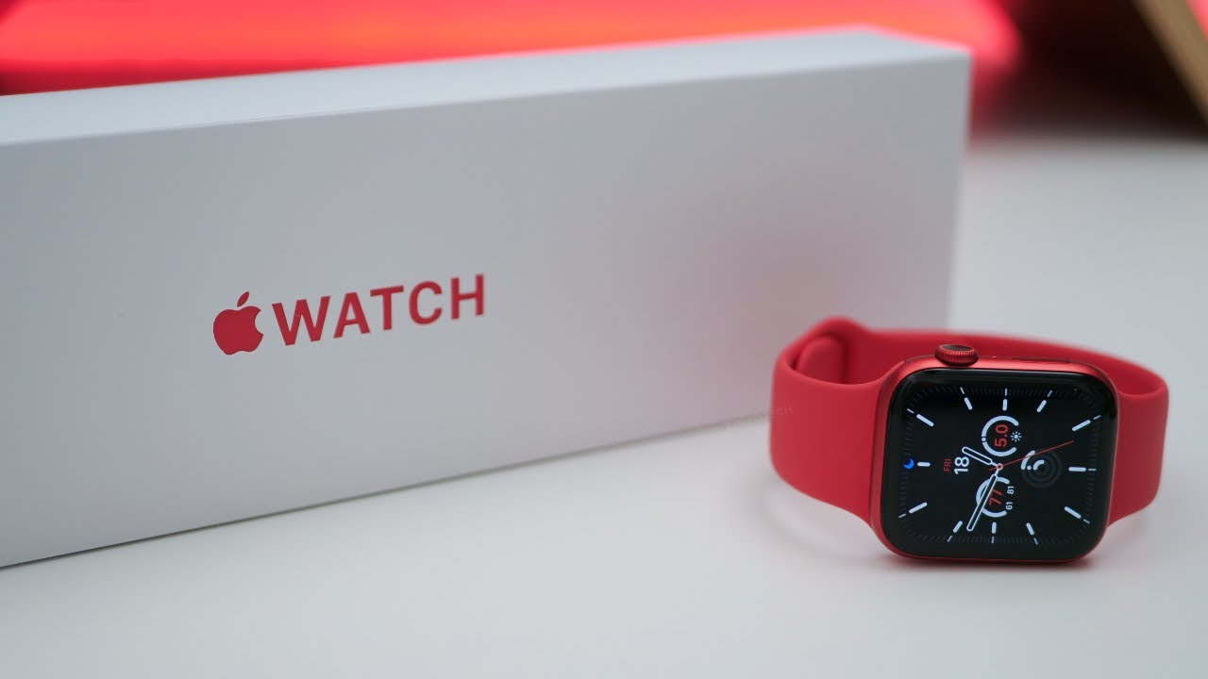
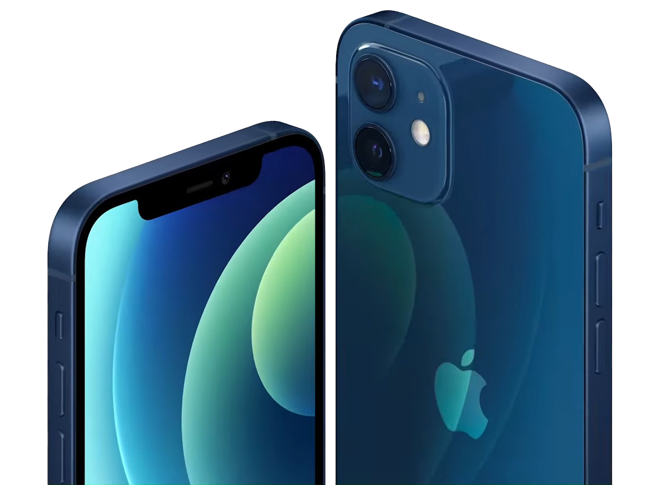
Company Name Dominates Brand Name

Slide 16
Company Name Dominates Brand Name

Slide 17



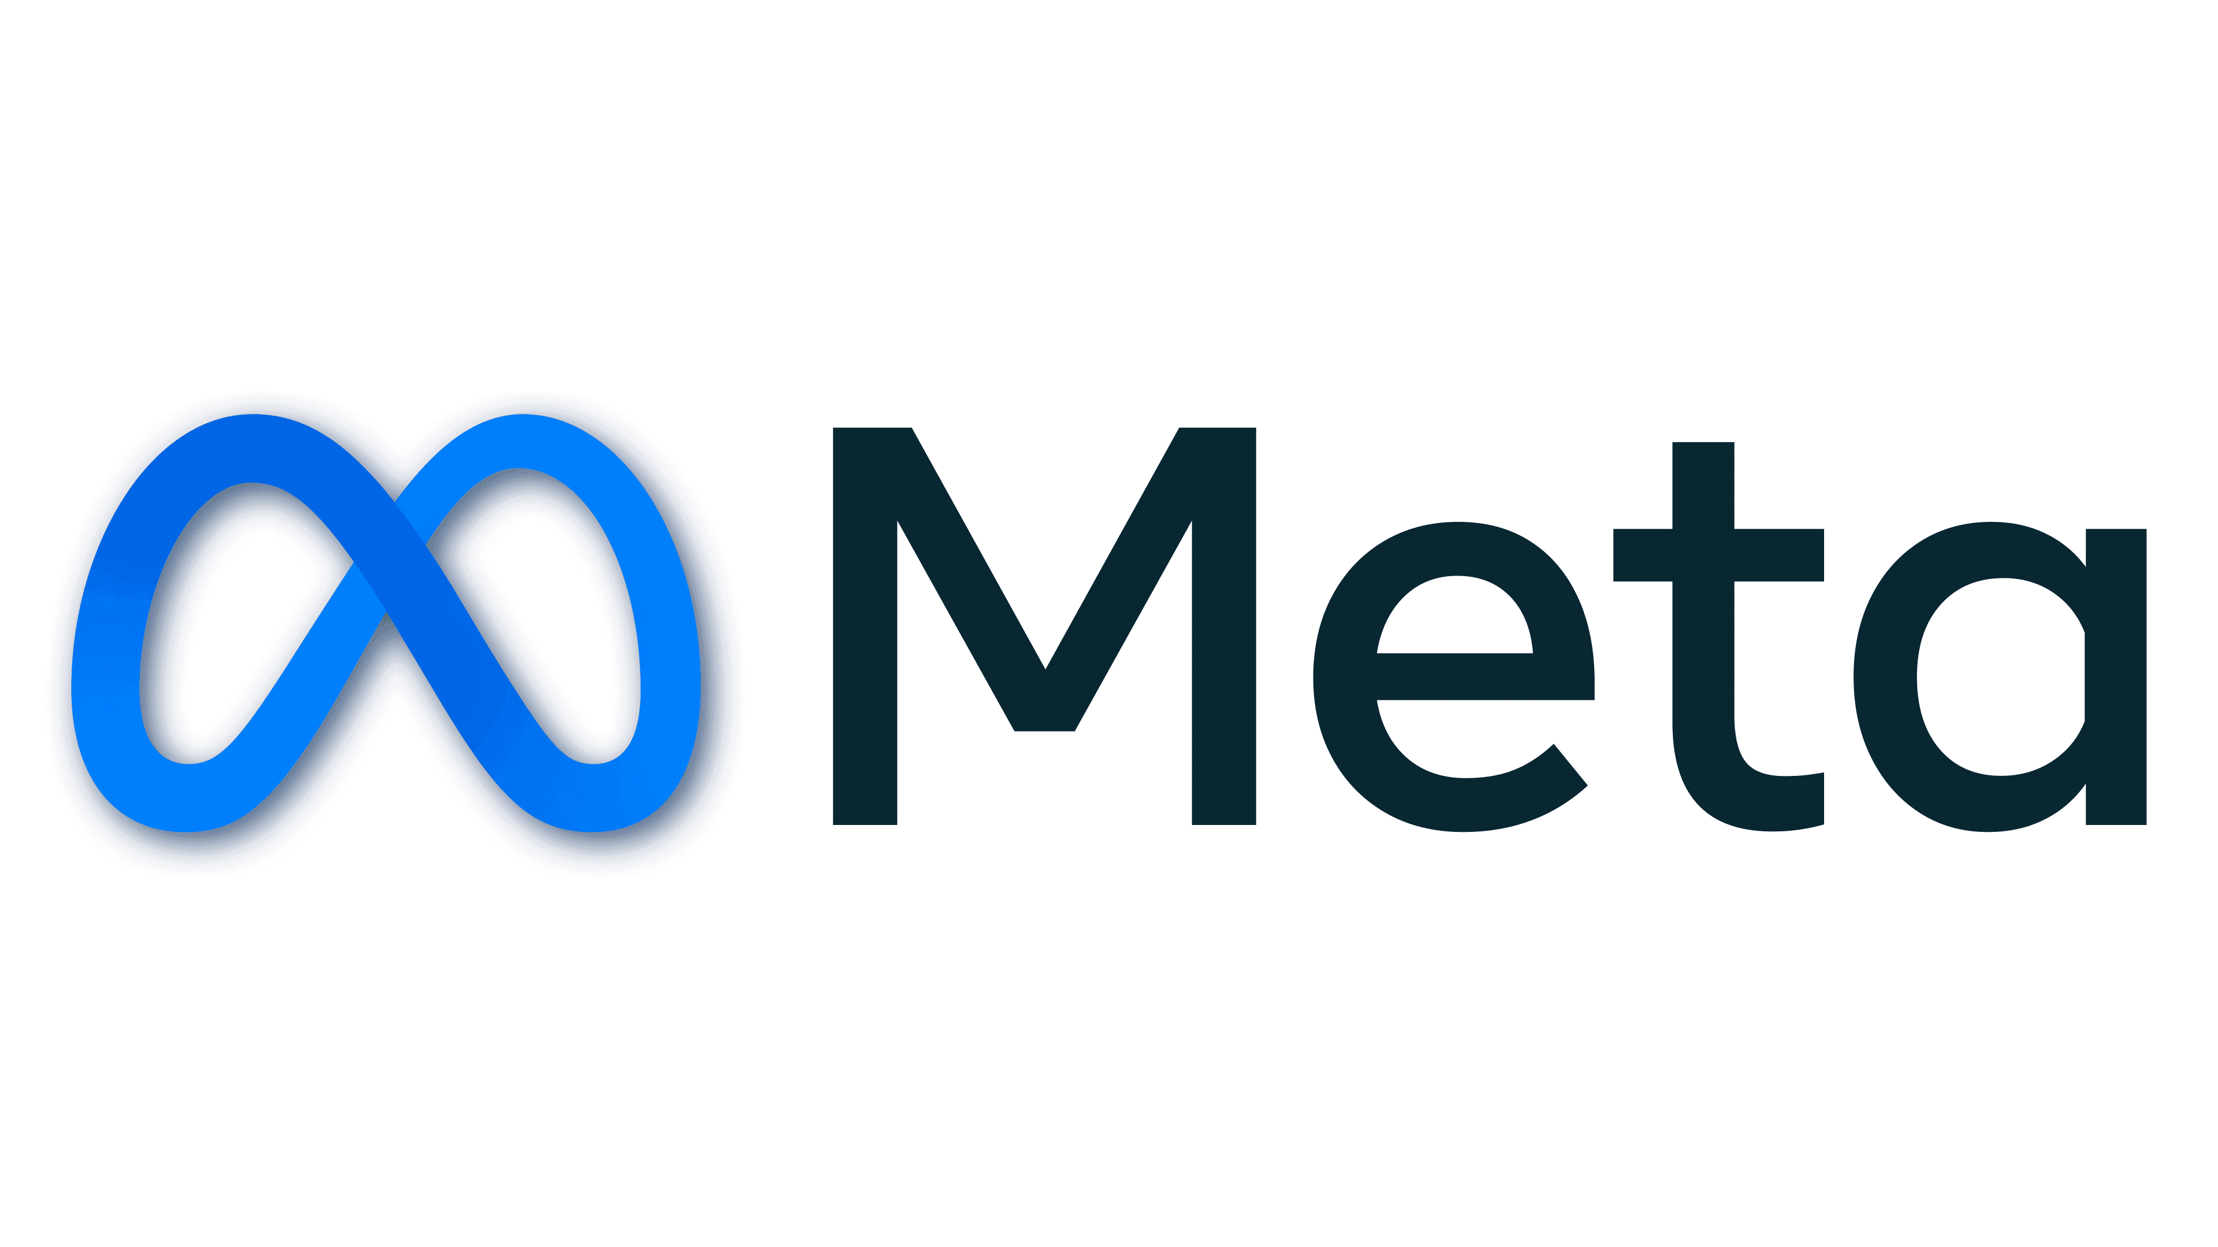
Brand Name Dominates Company Name
…........

Slide 18
Brand Name Dominates Company Name
…........

Slide 19
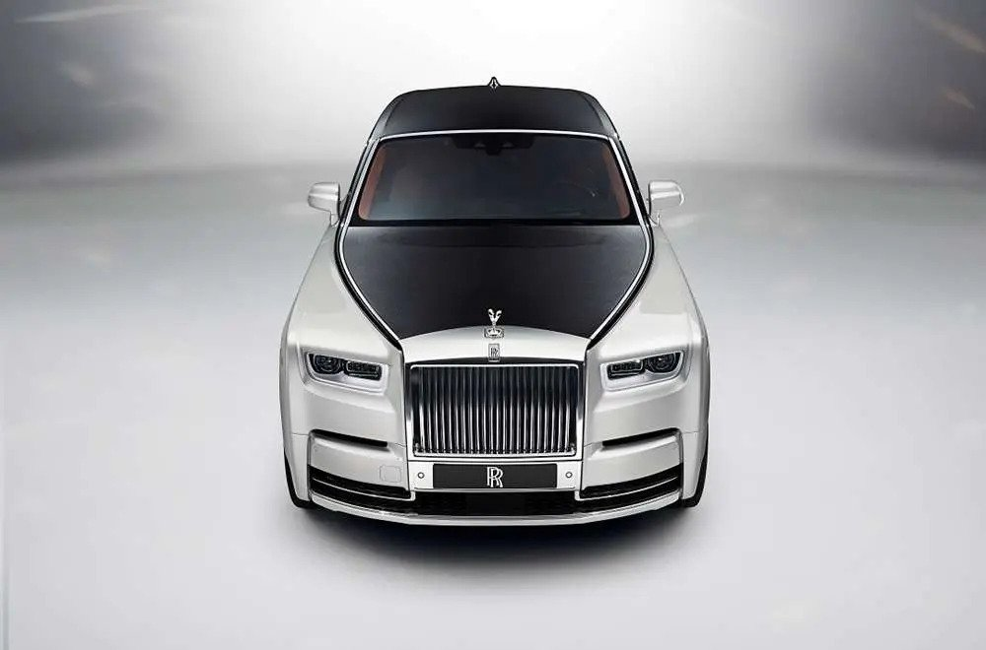
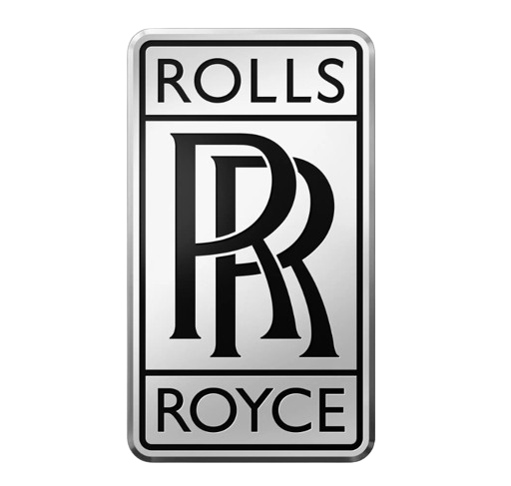
Equal Weightage
Company Name
Product Name

Slide 20
Equal Weightage
Company Name
Product Name

Slide 21
Ask Yourself
Most issues involving Company names VS Brand names can be
solved by asking yourself two questions:
1. What is the name of the brand?
2. What is the name of the stuff inside the packaging?

Slide 22
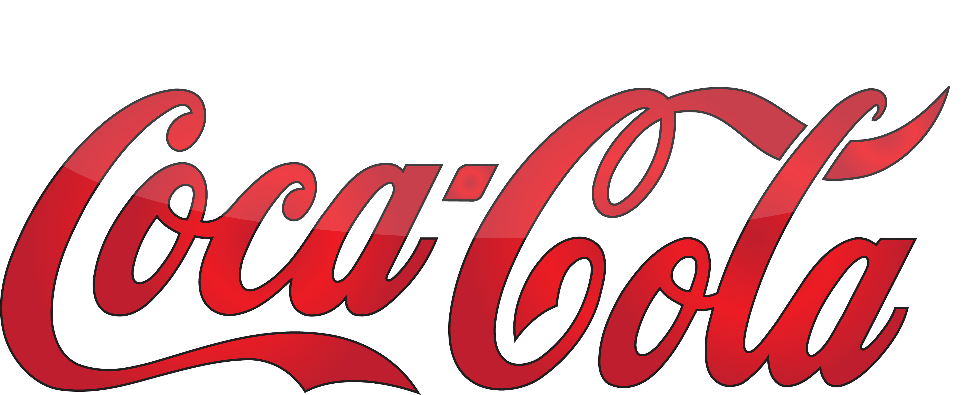
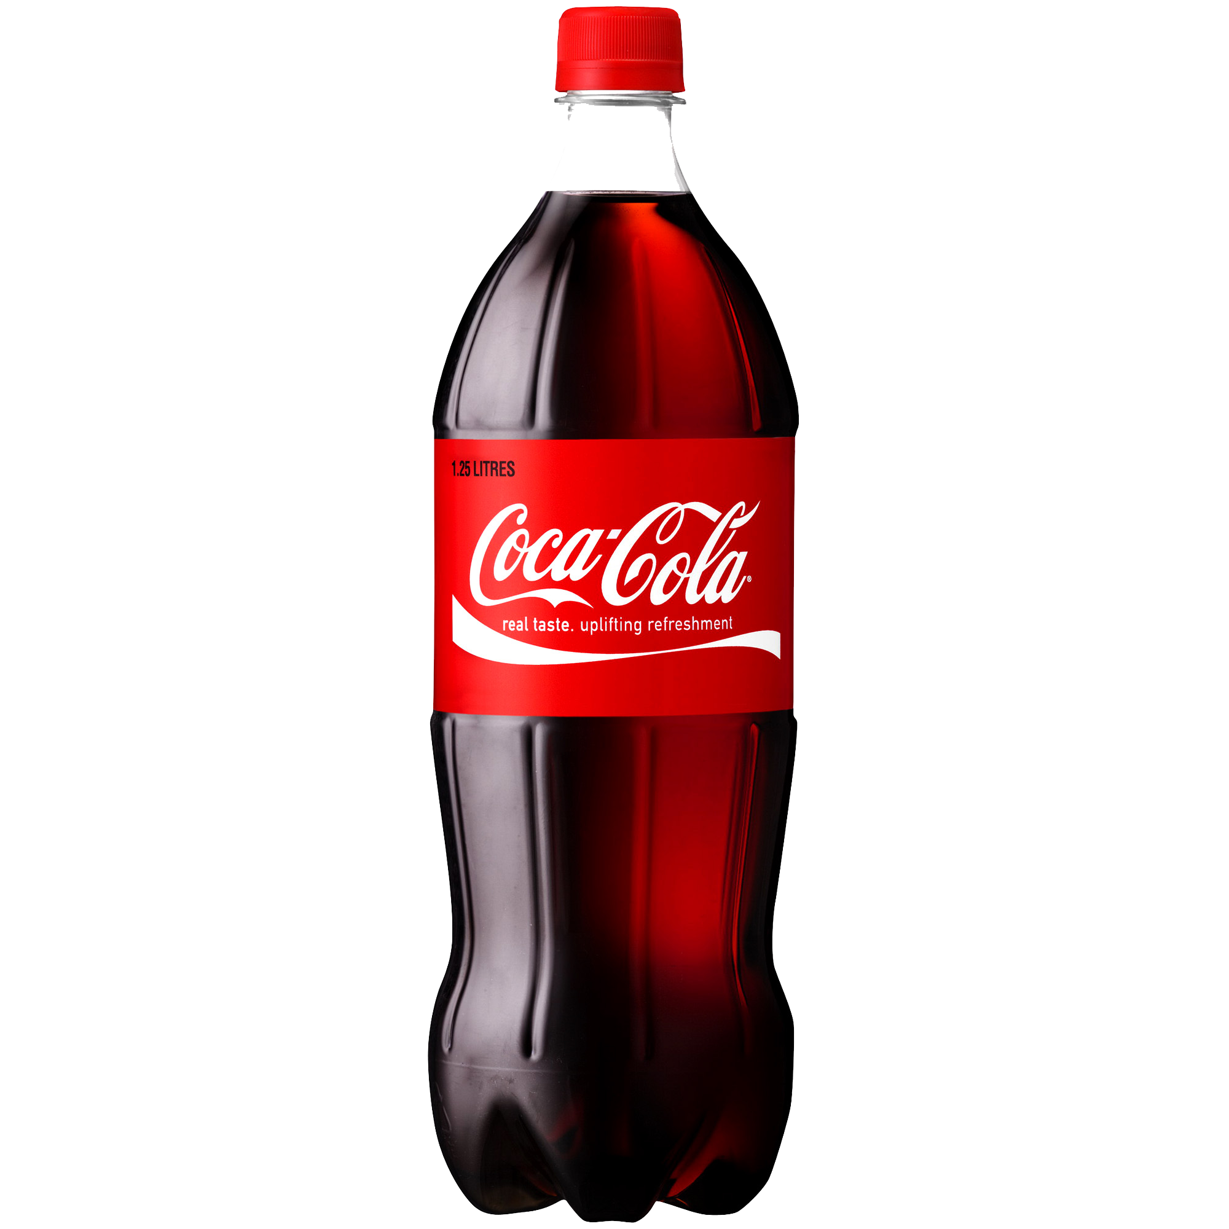
Best Case
Product
Name

Slide 23
Best Case
Company
Name
Product
Name

Slide 24
Best Case
Company
Name
Product
Name
Inside Packaging

Slide 25
The Law
Of Sub Brands

Slide 26
◤✧ 𝖂𝖍𝖆𝖙 𝖇𝖗𝖆𝖓𝖉𝖎𝖓𝖌 𝖇𝖚𝖎𝖑𝖉𝖘, 𝖘𝖚𝖇𝖇𝖗𝖆𝖓𝖉𝖎𝖓𝖌 𝖈𝖆𝖓 𝖉𝖊𝖘𝖙𝖗𝖔𝖞. ✧◥

Slide 27
Goal of Sub-Branding
Main Goal: The goal of sub-branding is to reach new customers or to expand into new markets.
However, sub-branding can also be a risky strategy, Why is it risky?
…........
Dilute Core Brand Name
Confuses Customers

Slide 28
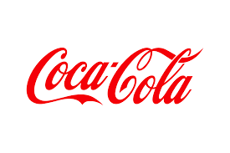
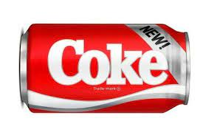
Consequences of Sub-Branding
In the 1980s, Coca-Cola attempted to replace its original formula with a new formula called New Coke. They faced severe criticism and back lash because of this sub-branding.

Slide 29
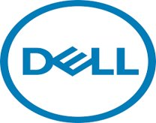


More Examples
Dell also had sub-brands such as Alienware and PowerEdge However, Alienware has been criticized for being too expensive and for not offering enough value for money. PowerEdge has been criticized for its lack of innovation and its focus on the enterprise market.​ ​ ​ ​ ​ ​ ​ ​ ​

Slide 30
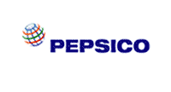
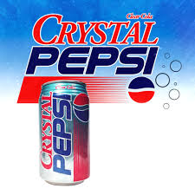
Subbranding of PepsiCo
PepsiCo is a global beverage company with a strong brand reputation. However, the company's attempt to launch a sub-brand called Crystal Pepsi in the 1990s was a failure. Crystal Pepsi was aimed at a younger, health-conscious market, but the brand failed to connect with consumers and was discontinued after just two years.
…........

Slide 31
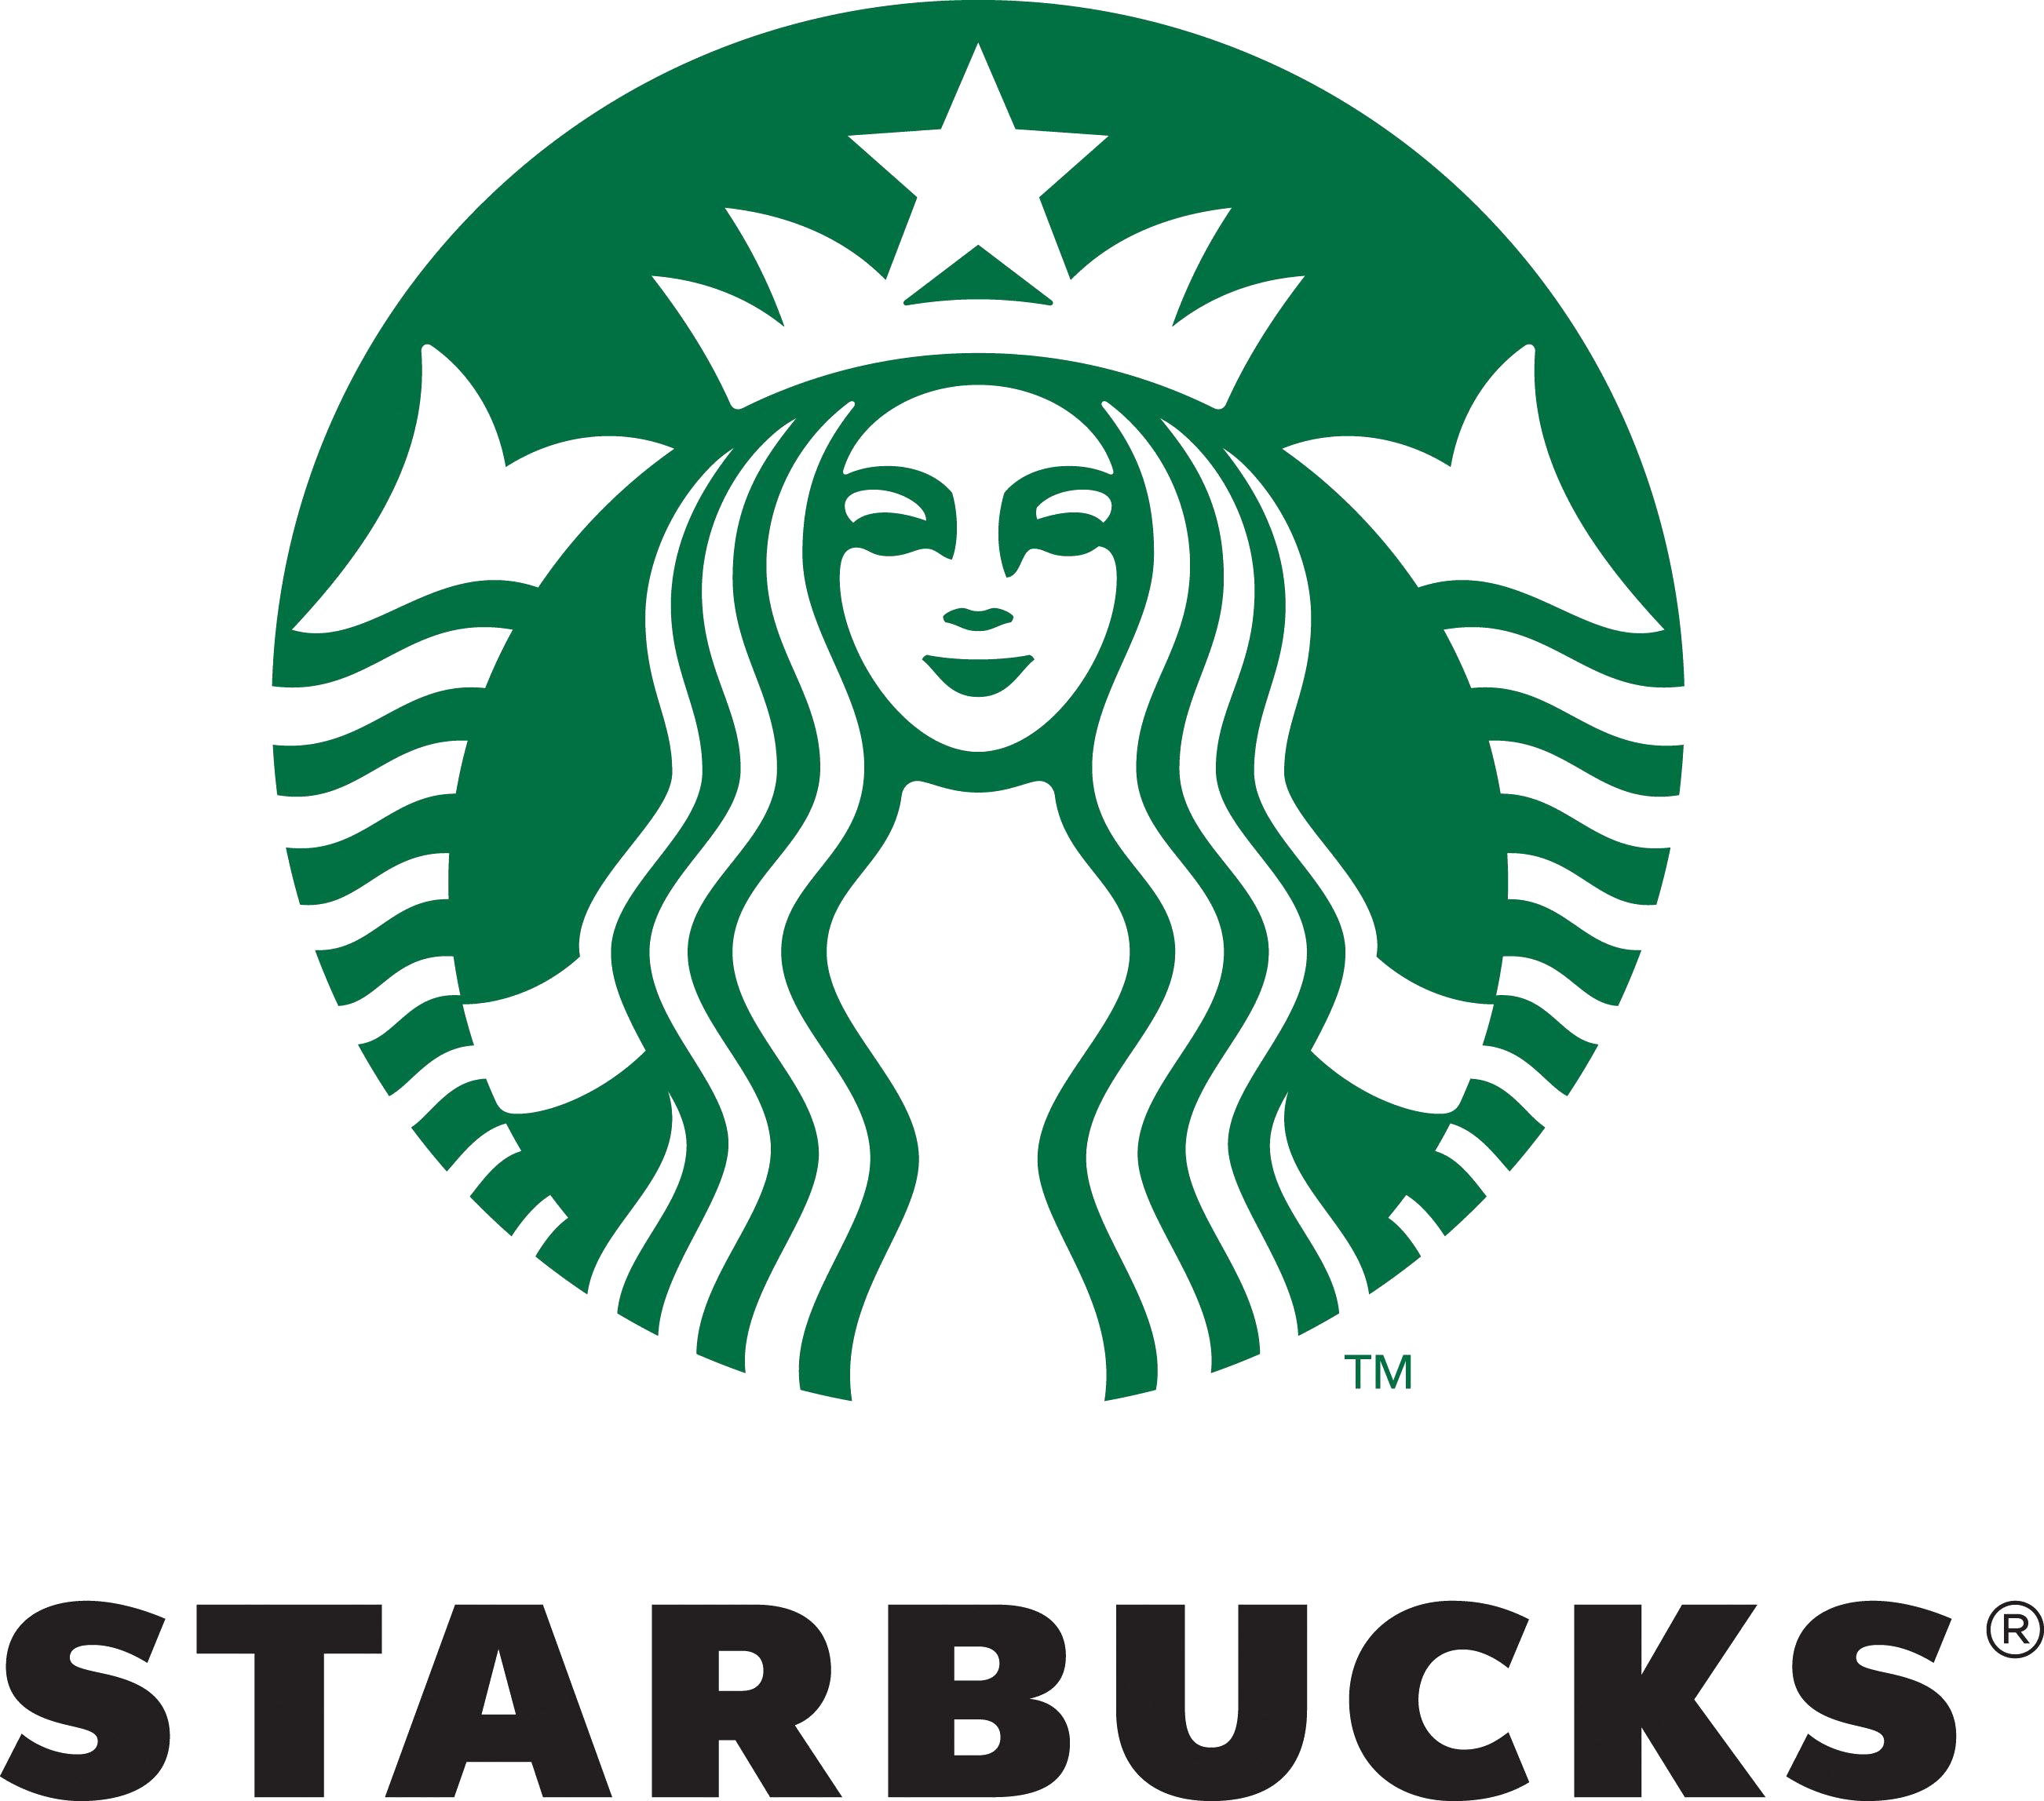
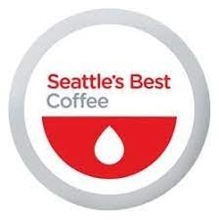
Subbranding
In 2003, Starbucks acquired Seattle's Best Coffee, a smaller coffee chain, with the intention of expanding its reach and competing with McDonald's McCafé. However, Seattle's Best Coffee has struggled to differentiate itself from Starbucks, and its marketing efforts have been largely unsuccessful.
…........

Slide 32


Sub branding
HP is a well-known American multinational information technology company. However, some of its sub-brands, such as Compaq, has been discontinued due to lack of success. Sub-brand was criticized for failing to resonate with consumers and for not offering a compelling reason to exist.
…........

Slide 33
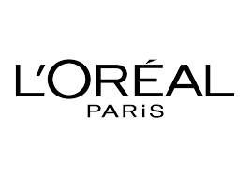
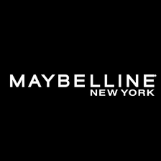
Sub branding
L'Oréal, a French multinational personal care company, has had varying degrees of success with its sub-brands, such as Maybelline. As, Maybelline has struggled to differentiate itself from competitors in the mass market.
…........

Slide 34
THANKS
Any Questions Are Welcomed

